Slide 1
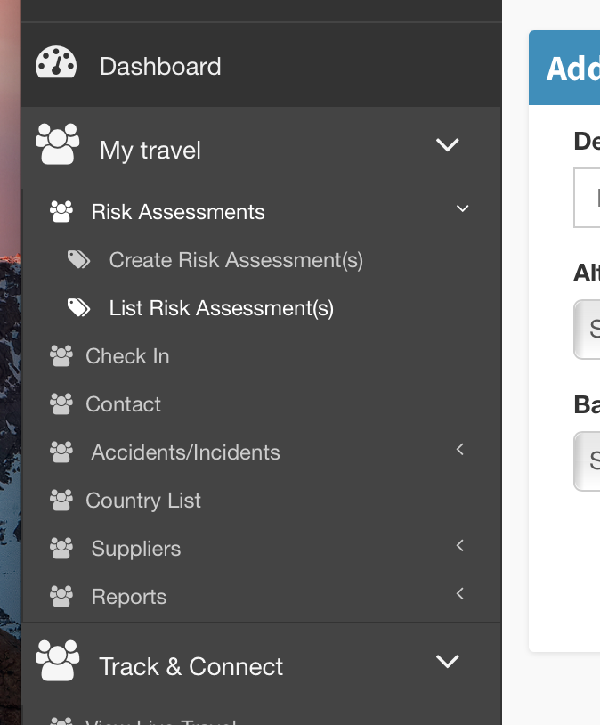
Administrator Risk Assessment

Slide 2
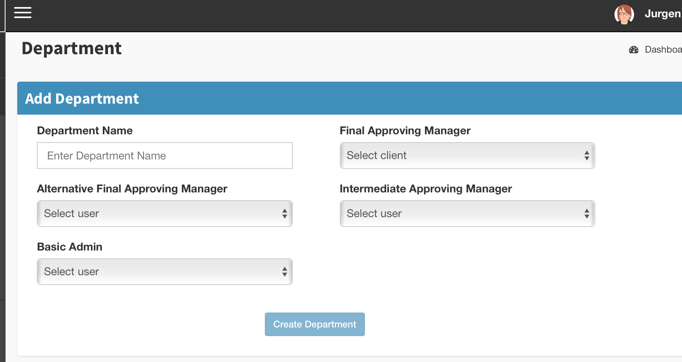
NOTE THIS VIEW HAS CHANGED WITH COMPLETION OF TICKET 84
Choice of Administrator here determines permission to write RAs for other department members. Not this must be indefinite list

Slide 3
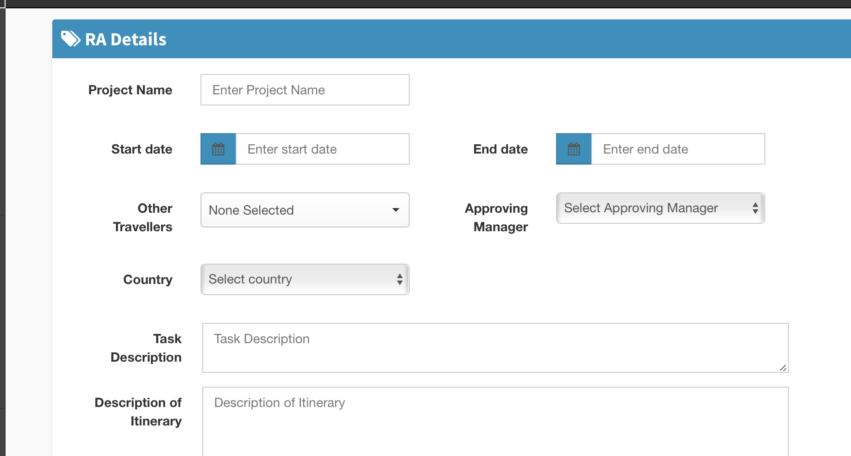
Assign Primary Traveller

Slide 4
Are you travelling on this assignment? Y/N
If No, open look up.
Primary Traveller

